Slide 1
Itemsets, Vectors/matrices, and Sequences

Slide 2
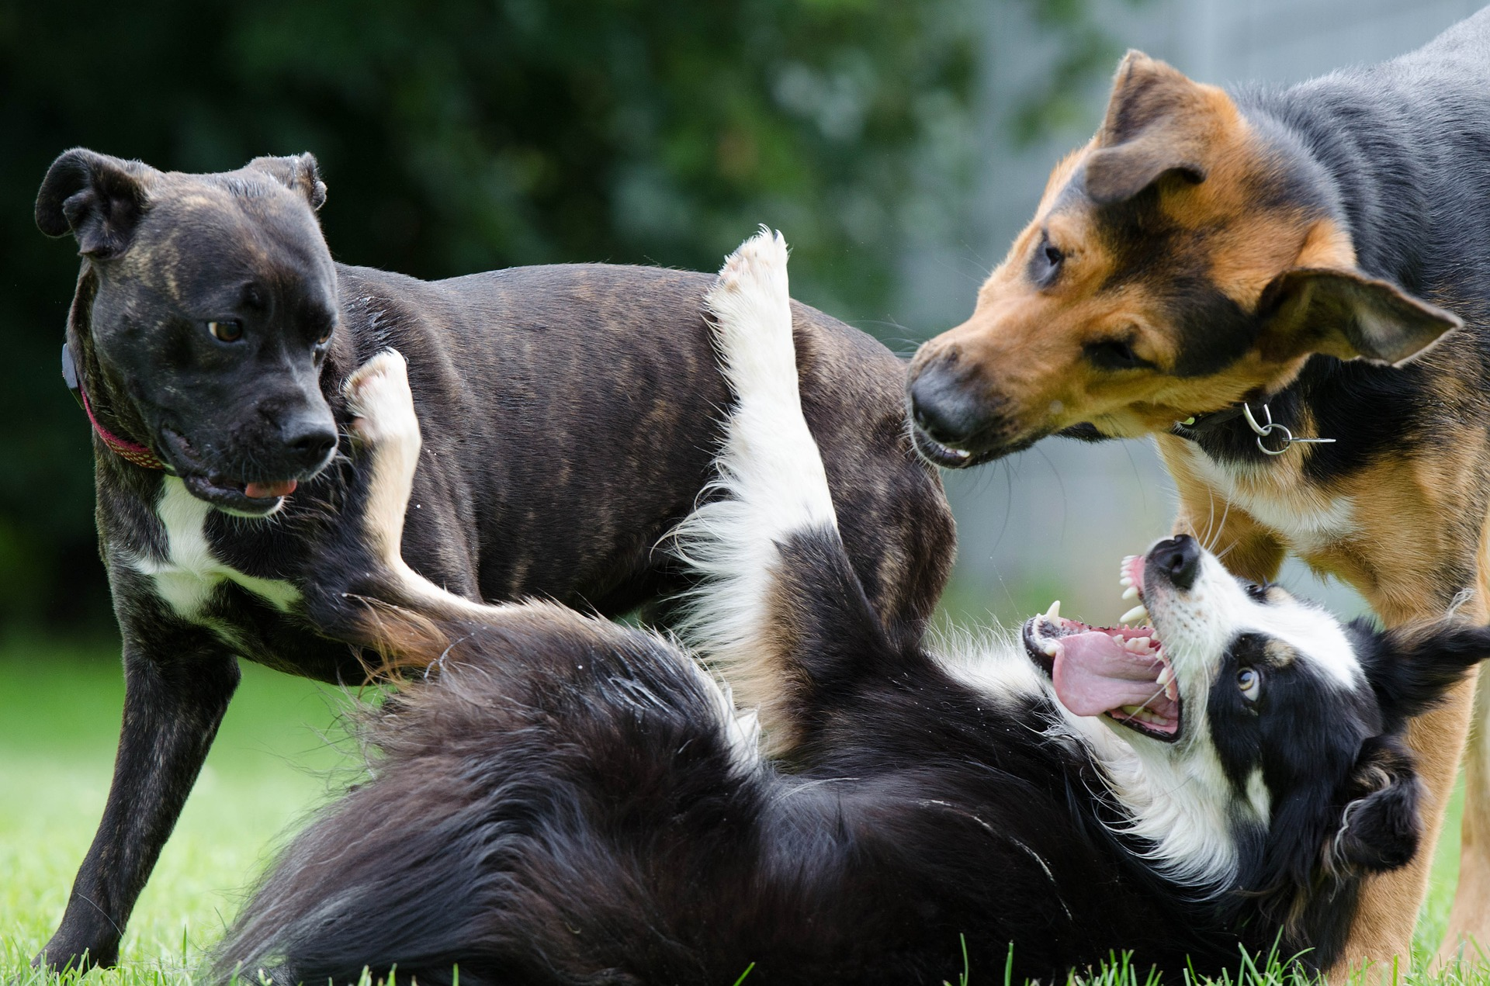
Data Representations
Item Set
Vector / Matrix
Sequence
Time Series
Spatial
Spatiotemporal
Graph / Network
Stream

Slide 3
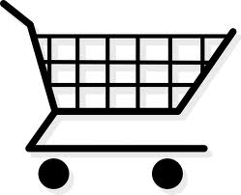
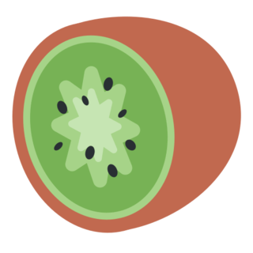






Itemset Data
Data Object: a shopping basket, a piece of text, a board of directors, …
Attribute: appearance of a categorical item
a product, a word, a person, etc.
Emojis - Twitter - https://twemoji.twitter.com/ - CC-BY-4.0

Slide 4
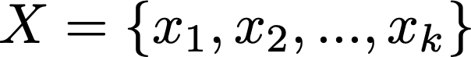
The Itemset Representation
Each data object is represented as a set of items:
x_{i} belongs to X if and only if that categorical item appears in the set.
Order or counts of the items don’t matter

Slide 5
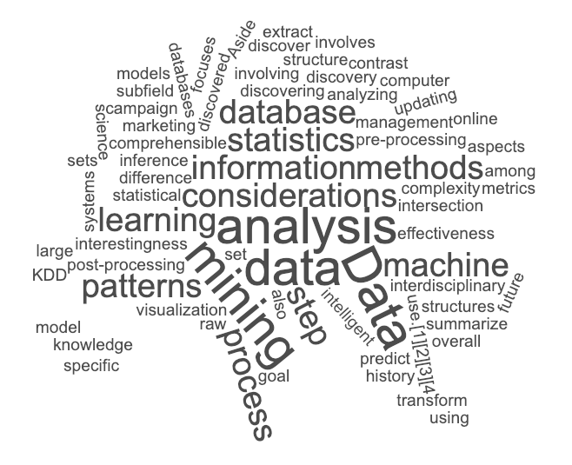

Example of Itemsets
Shopping Baskets:
Text (as bag-of-words):
Emojis - Twitter - https://twemoji.twitter.com/ - CC-BY-4.0

Slide 6
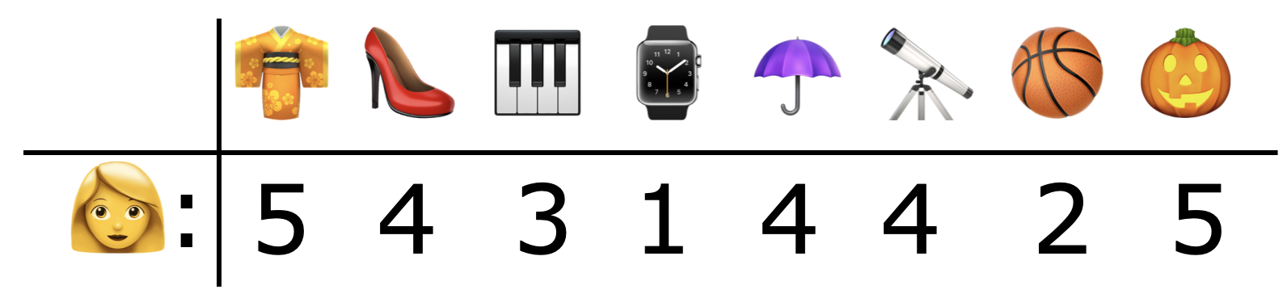








Vector Data
Data Object: E.g., a user’s ratings of products, or course grades of a student
Attribute: a numerical property of the object.
E.g., Kimono=5; Shoe=4; Piano=3, etc.
Emojis - Twitter - https://twemoji.twitter.com/ - CC-BY-4.0

Slide 7
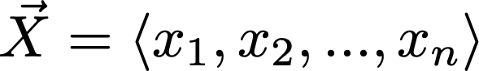
The Vector Representation
Data represented as n-dimensional vectors:
Each dimension corresponds to one attribute
x_{i} is the numerical value of X at the i^{th} dimension (attribute).

Slide 8
The Vector Representation
Data represented as n-dimensional vectors:
Each dimension corresponds to one attribute
x_{i} is the numerical value of X at the i^{th} dimension (attribute).
Each attribute is unique; cannot change order.

Slide 9
The Vector Representation
Data represented as n-dimensional vectors:
Each dimension corresponds to one attribute
x_{i} is the numerical value of X at the i^{th} dimension (attribute).
Multiple objects → a matrix (a collection of vectors).

Slide 10
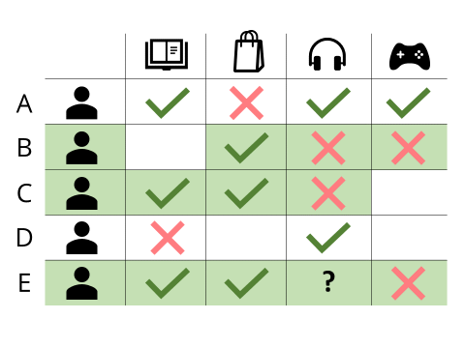
Example of Matrices
Product Ratings
https://www.incubegroup.com/blog/recommender-system-for-private-banking/

Slide 11
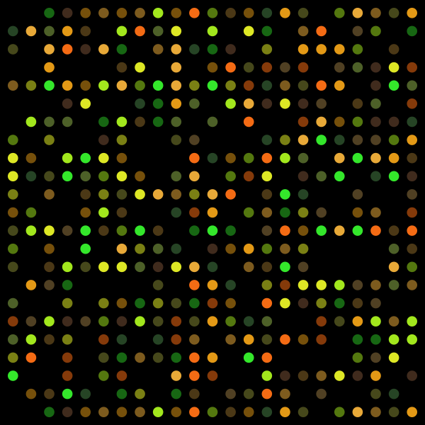
Example of Matrices
Product Ratings
Microarrays
Samples
Gene Expression Level
Genes
https://www.incubegroup.com/blog/recommender-system-for-private-banking/
DNA Micro array - Guillaume Paumier - https://commons.wikimedia.org/wiki/File:DNA_microarray.svg - CC-BY-SA-3.0

Slide 12
Sequence Data
Data object: curriculum paths, a DNA sequence, a session of search queries, a sentence (of words), a trace of user actions
Attributes: pairs of positions and categorical item, in a sequential order

Slide 13
Sequence Data
Data object: curriculum paths, a DNA sequence, a session of search queries, a sentence (of words), a trace of user actions
Attributes: pairs of positions and categorical item, in a sequential order
Introduction to Python
Python for Data Science
Data Mining I
Data Mining II
(For a degree program, each course and its position are set in a sequential order)

Slide 14

The Sequence Representation
Data represented as a sequence of items:
x_{i} is the categorical item appeared at the i^{th} position of X.

Slide 15
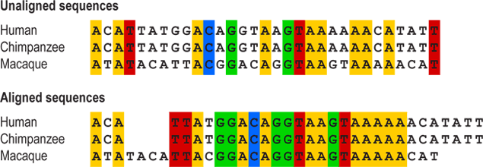
Example of Sequences
DNA sequences
Image source: https://evolution.berkeley.edu/evolibrary/article/0_0_0/evotrees_build_04
Notes:
DNA is made up of a sequence of only four possible bases (A, T, C, or G). When compare the DNAs of different species, it can be hard to tell which positions in the sequences of the different species should be compared to one another. To solve this problem, biologists can align the sequences by inserting blank spaces.

Slide 16
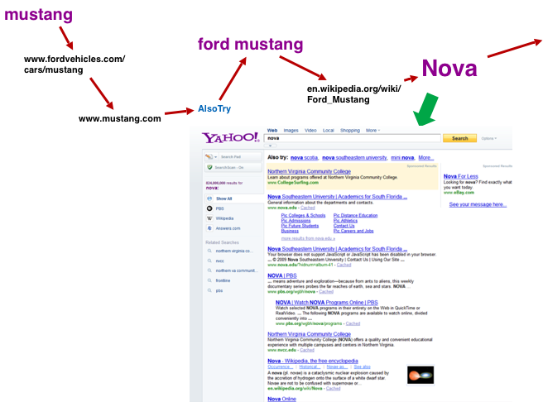
Example of Sequences
DNA sequences
Search sequence
Image source: https://evolution.berkeley.edu/evolibrary/article/0_0_0/evotrees_build_04
Notes:
DNA is made up of a sequence of only four possible bases (A, T, C, or G). When compare the DNAs of different species, it can be hard to tell which positions in the sequences of the different species should be compared to one another. To solve this problem, biologists can align the sequences by inserting blank spaces.

Slide 17


School of Information, University of Michigan
Qiaozhu Mei
School of Information
All Content © Presenter

